Slide 1

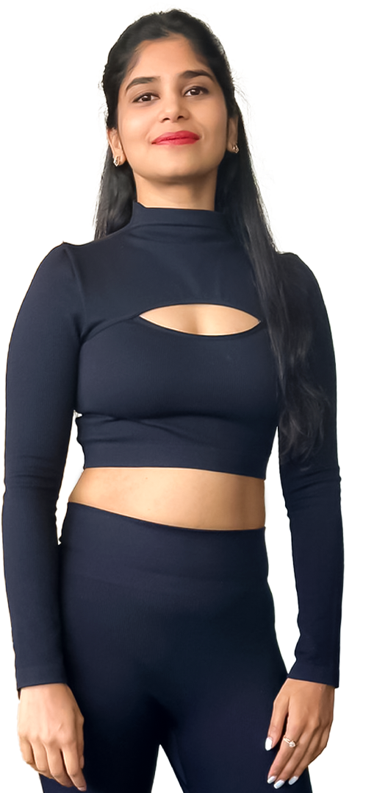

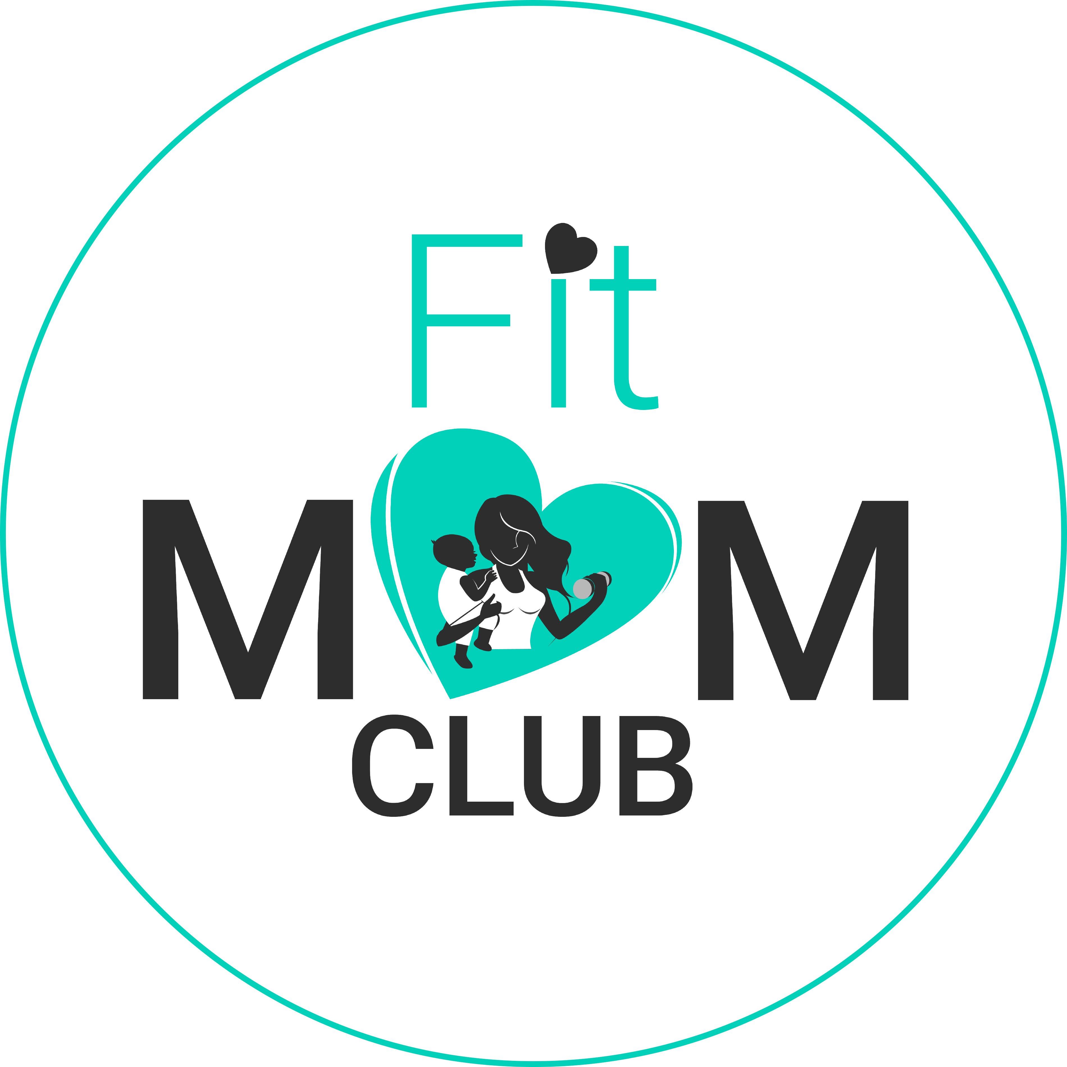
Brand Partnership
Notes:
In today’s wellness and maternal care landscape, partnerships are no longer optional but essential. Collaborations allow brands to tap into trusted communities like FitMom Club, where authenticity and credibility matter most. By joining forces, we can extend our reach, share resources, and create programs that resonate deeply with mothers and families. This not only reduces marketing costs but also builds stronger brand equity through meaningful engagement. Ultimately, brand partnerships in this space open new growth channels while delivering real value to the communities we serve

Slide 2
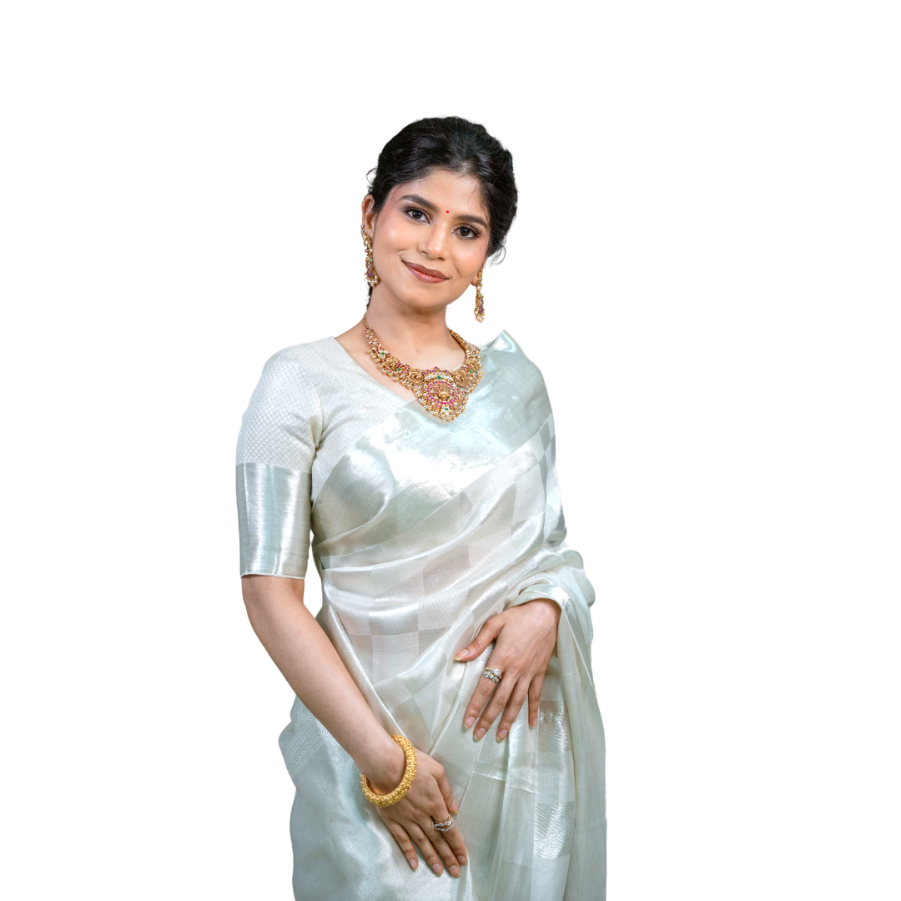

OUTLINE
  About FitMom Club
  5. Our Partnership Model
  2. Our Team & Strengths
  6. Value for Momz Cradle
  Clients
  3. Program Offerings
  7. How our Partnership Works
  4. Key Benefits for You
  8. Revenue Projection
© 2025 FitMom Club. All Rights Reserved
Notes:
To give you a clear roadmap of today’s discussion, we’ll begin with a quick introduction about FitMom Club and our journey, followed by an overview of our core team that drives this vision. Then we’ll walk through our program offerings and the influencer revenue model that strengthens our community engagement. From there, we’ll move into the brand partnership model and highlight the key benefits such collaborations can bring. We’ll also showcase our growth and milestones so far, and finally, we’ll conclude with the opportunities ahead and the next steps to take this partnership forward

Slide 3
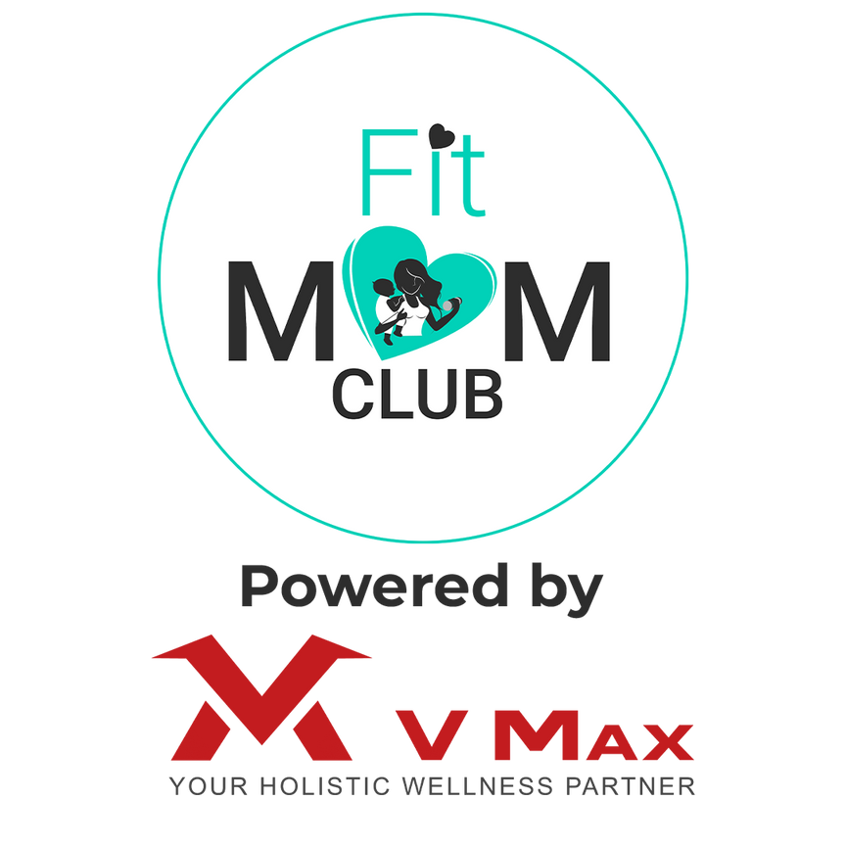
About
FitMom Club
FitMom Club is a science-backed, women-centric wellness brand committed to helping individuals transform their physical and emotional health whether they’re mothers, working professionals or anyone navigating modern lifestyle challenges!
With over 1 Lakh lives positively impacted,
we offer structured coaching, personalized nutrition plans and guidance that inspires lasting life change!
© 2025 FitMom Club. All Rights Reserved

Slide 4
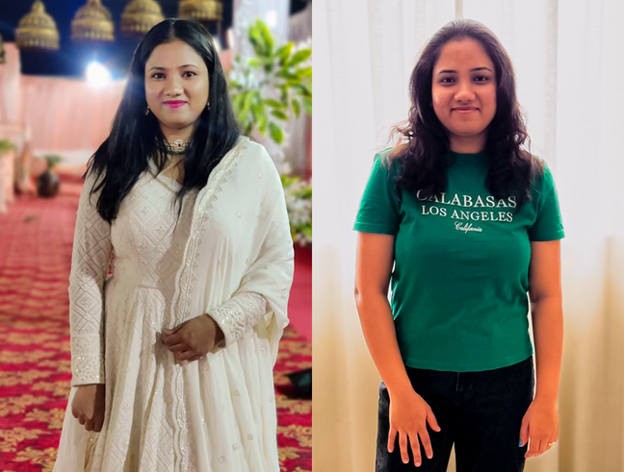
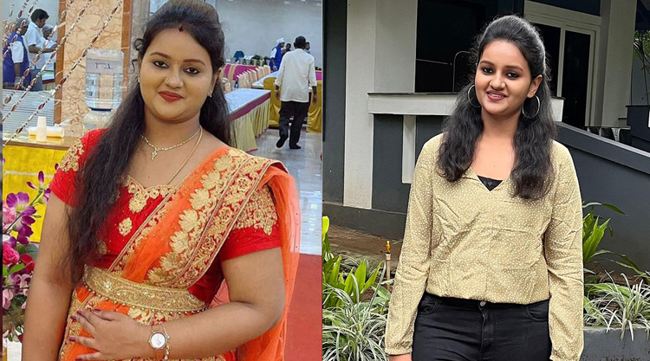
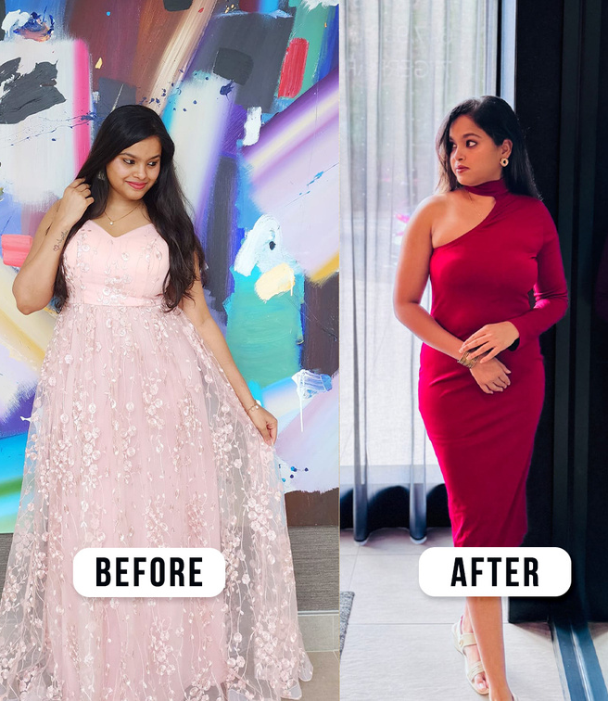
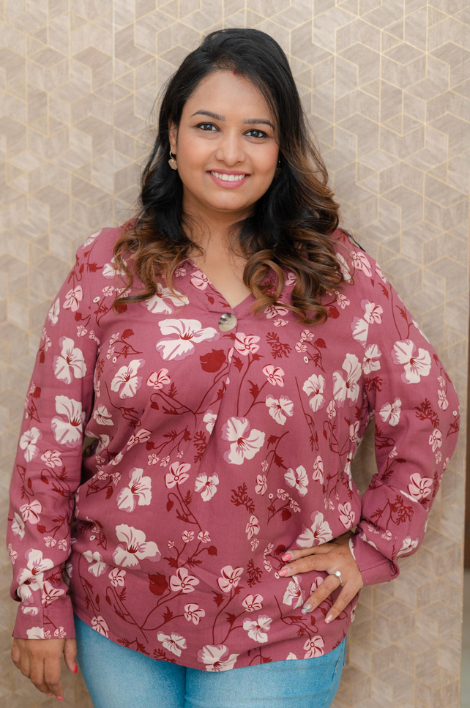
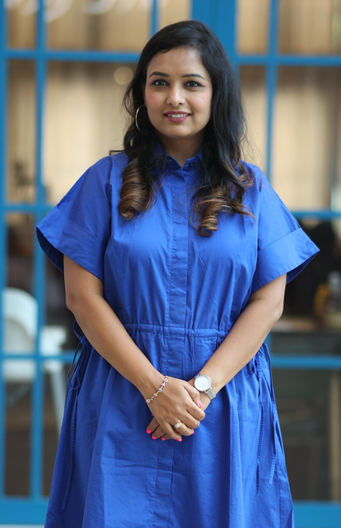
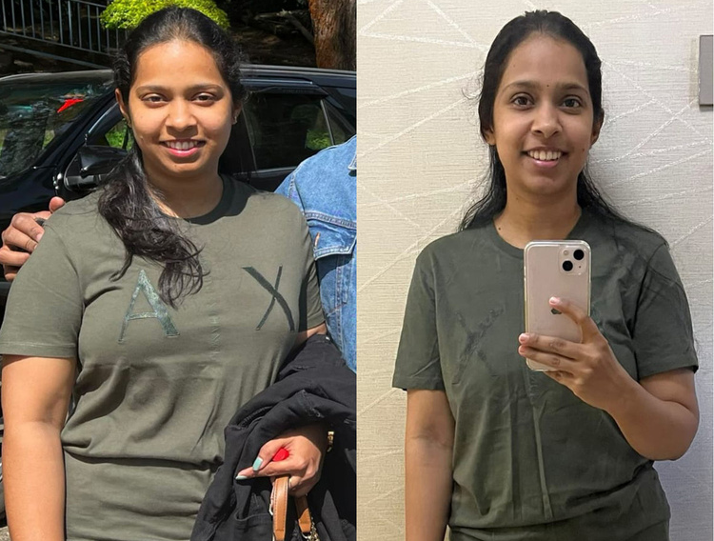
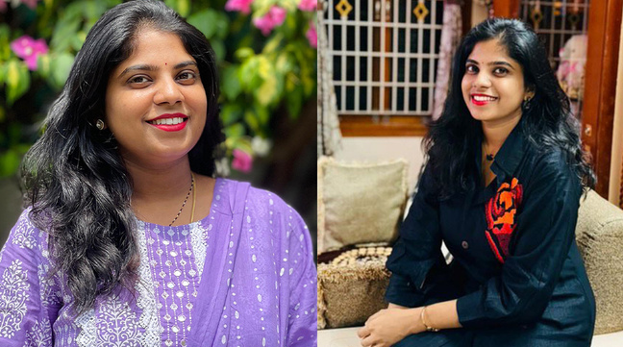

Vision
To create a world where mothers and women feel empowered to prioritize their health, well-being, and strength at every stage of life. We envision a future where holistic wellness is accessible, achievable, and sustainable for all.
Mission
To provide personalized fitness and nutrition solutions that inspire and empower individuals to achieve their health goals. We are committed to addressing both physical and mental well-being through expert guidance, tailored plans, and a supportive community that motivates and uplifts.
© 2025 FitMom Club. All Rights Reserved

Slide 5


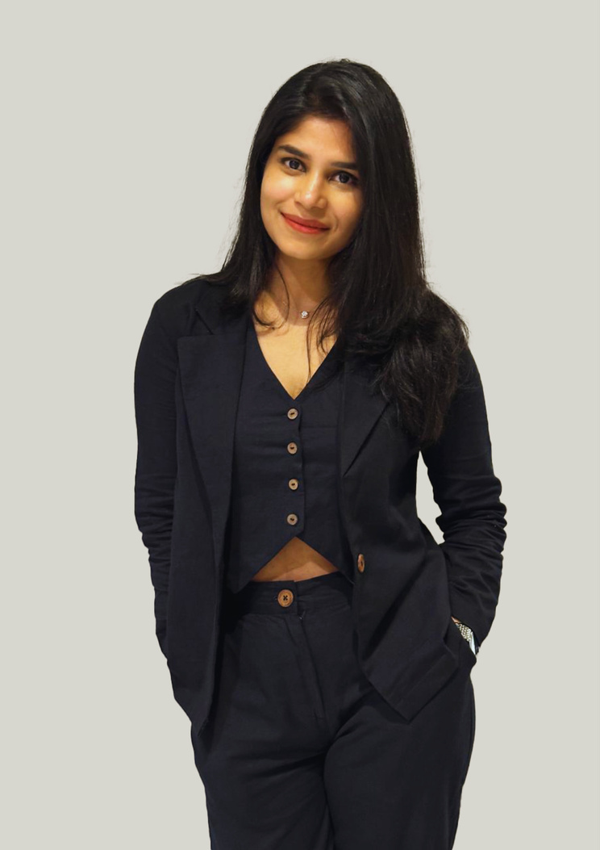
MEET THE FOUNDERS
Mr. Vignesh Prabakaran
Mr. Sarvesh Prabakaran
Ms. Pritika Srinivasan
Founder & Chief Business Director
Co-Founder & CEO
Co-Founder & Chief Evangelist
© 2025 FitMom Club. All Rights Reserved
Notes:
Our team at FitMom Club is a passionate group of professionals who bring together expertise in wellness, fitness, nutrition, technology, and community building. Each member plays a key role in driving our vision of empowering mothers and families with holistic solutions. What makes us strong is not just our individual skills but our collective commitment to creating meaningful impact and delivering trusted programs. This combination of knowledge, passion, and purpose ensures that we are well-positioned to build long-term and impactful partnerships.

Slide 6

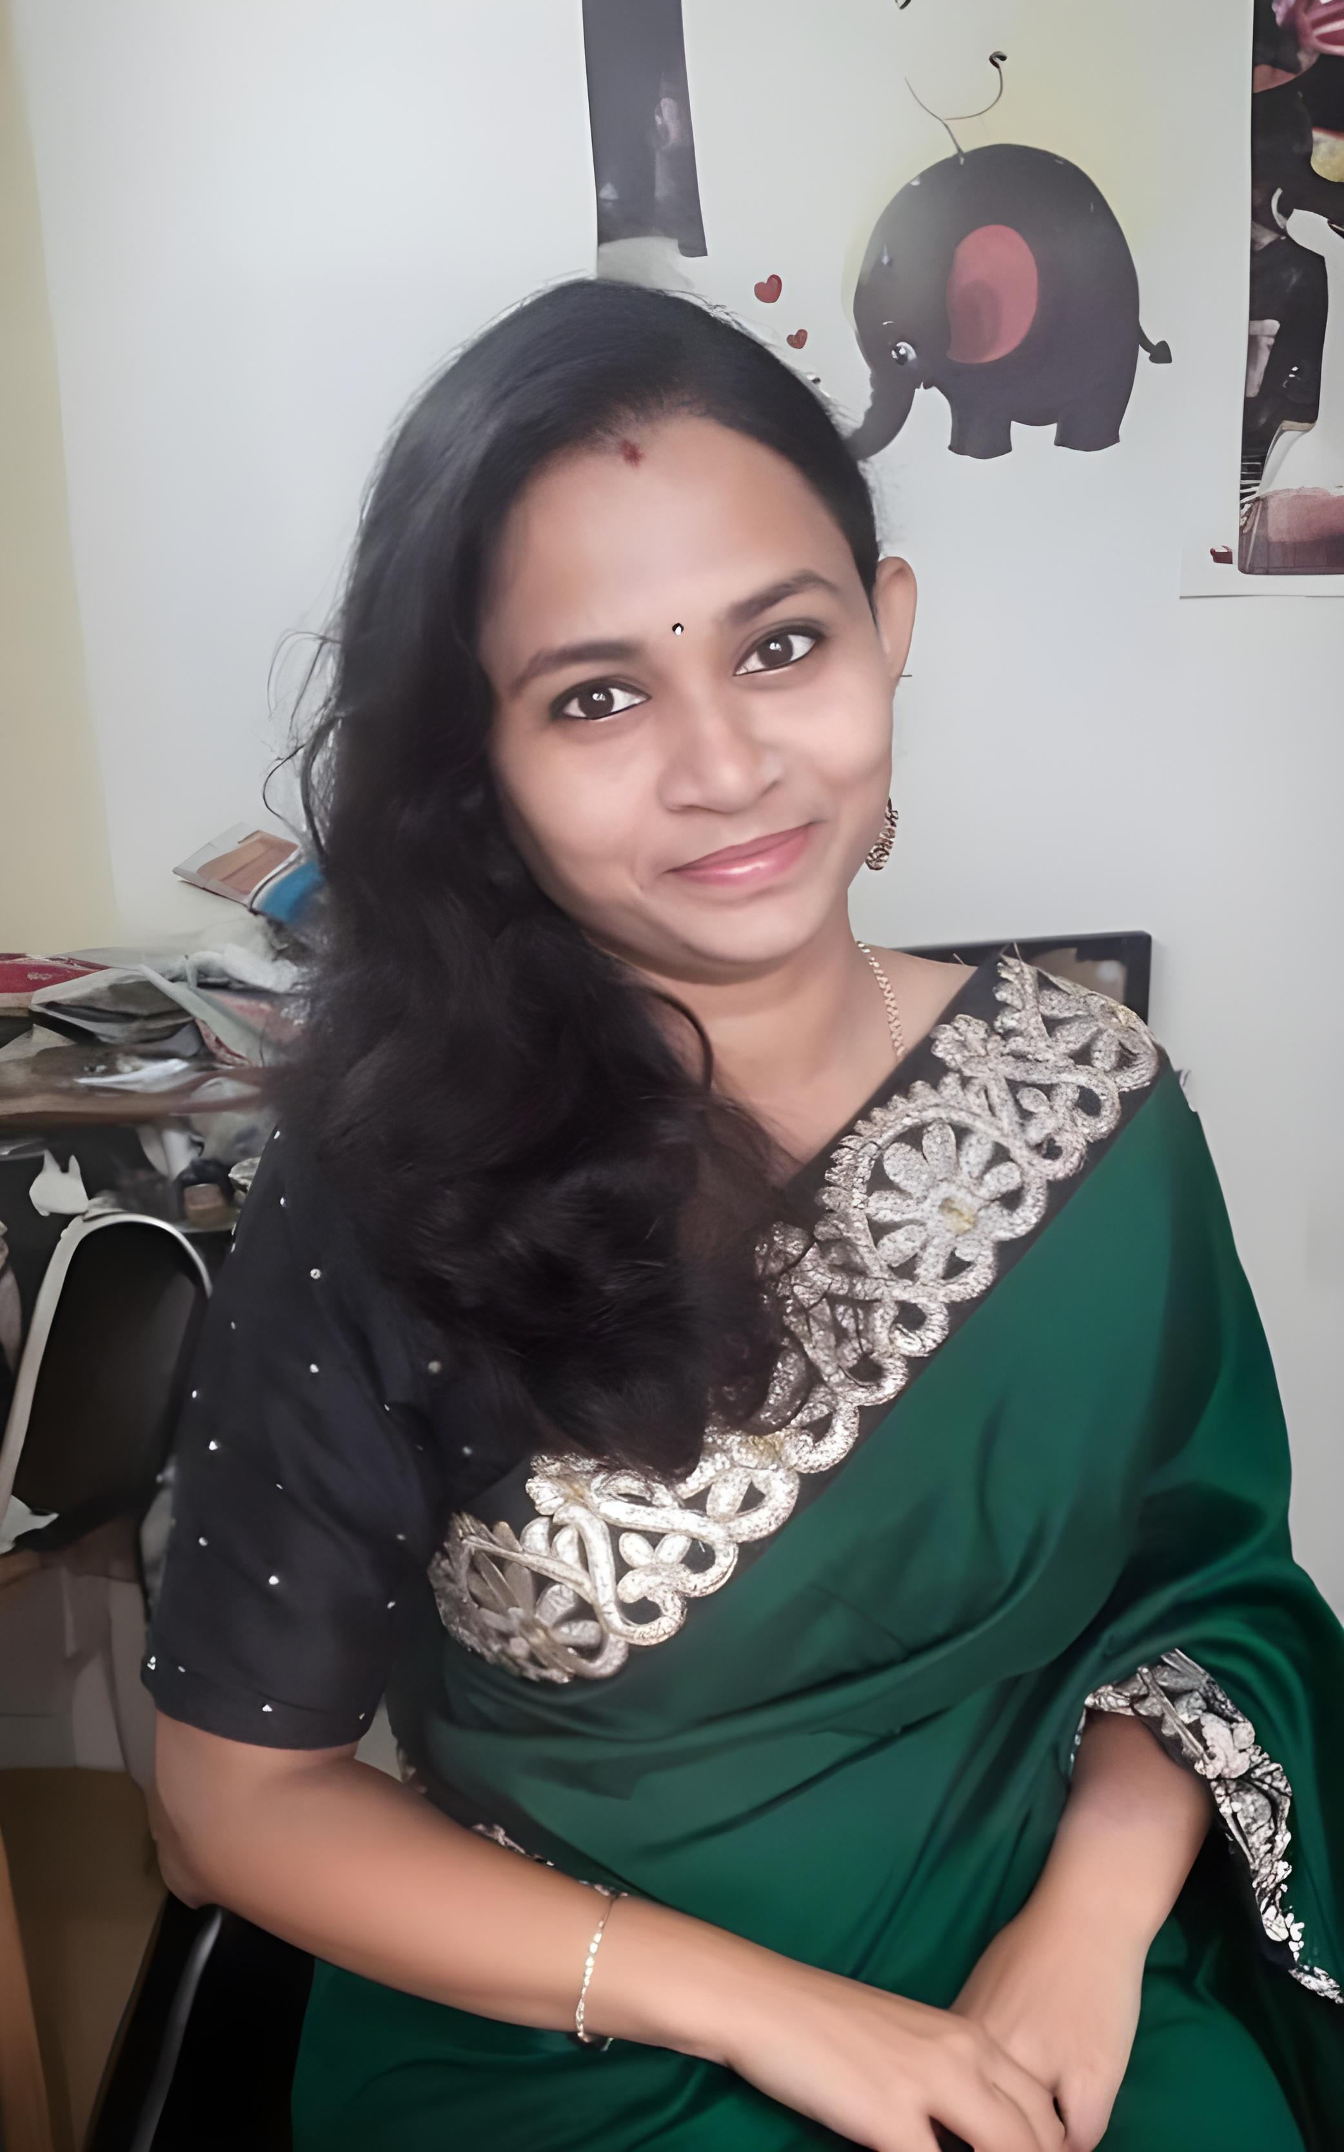
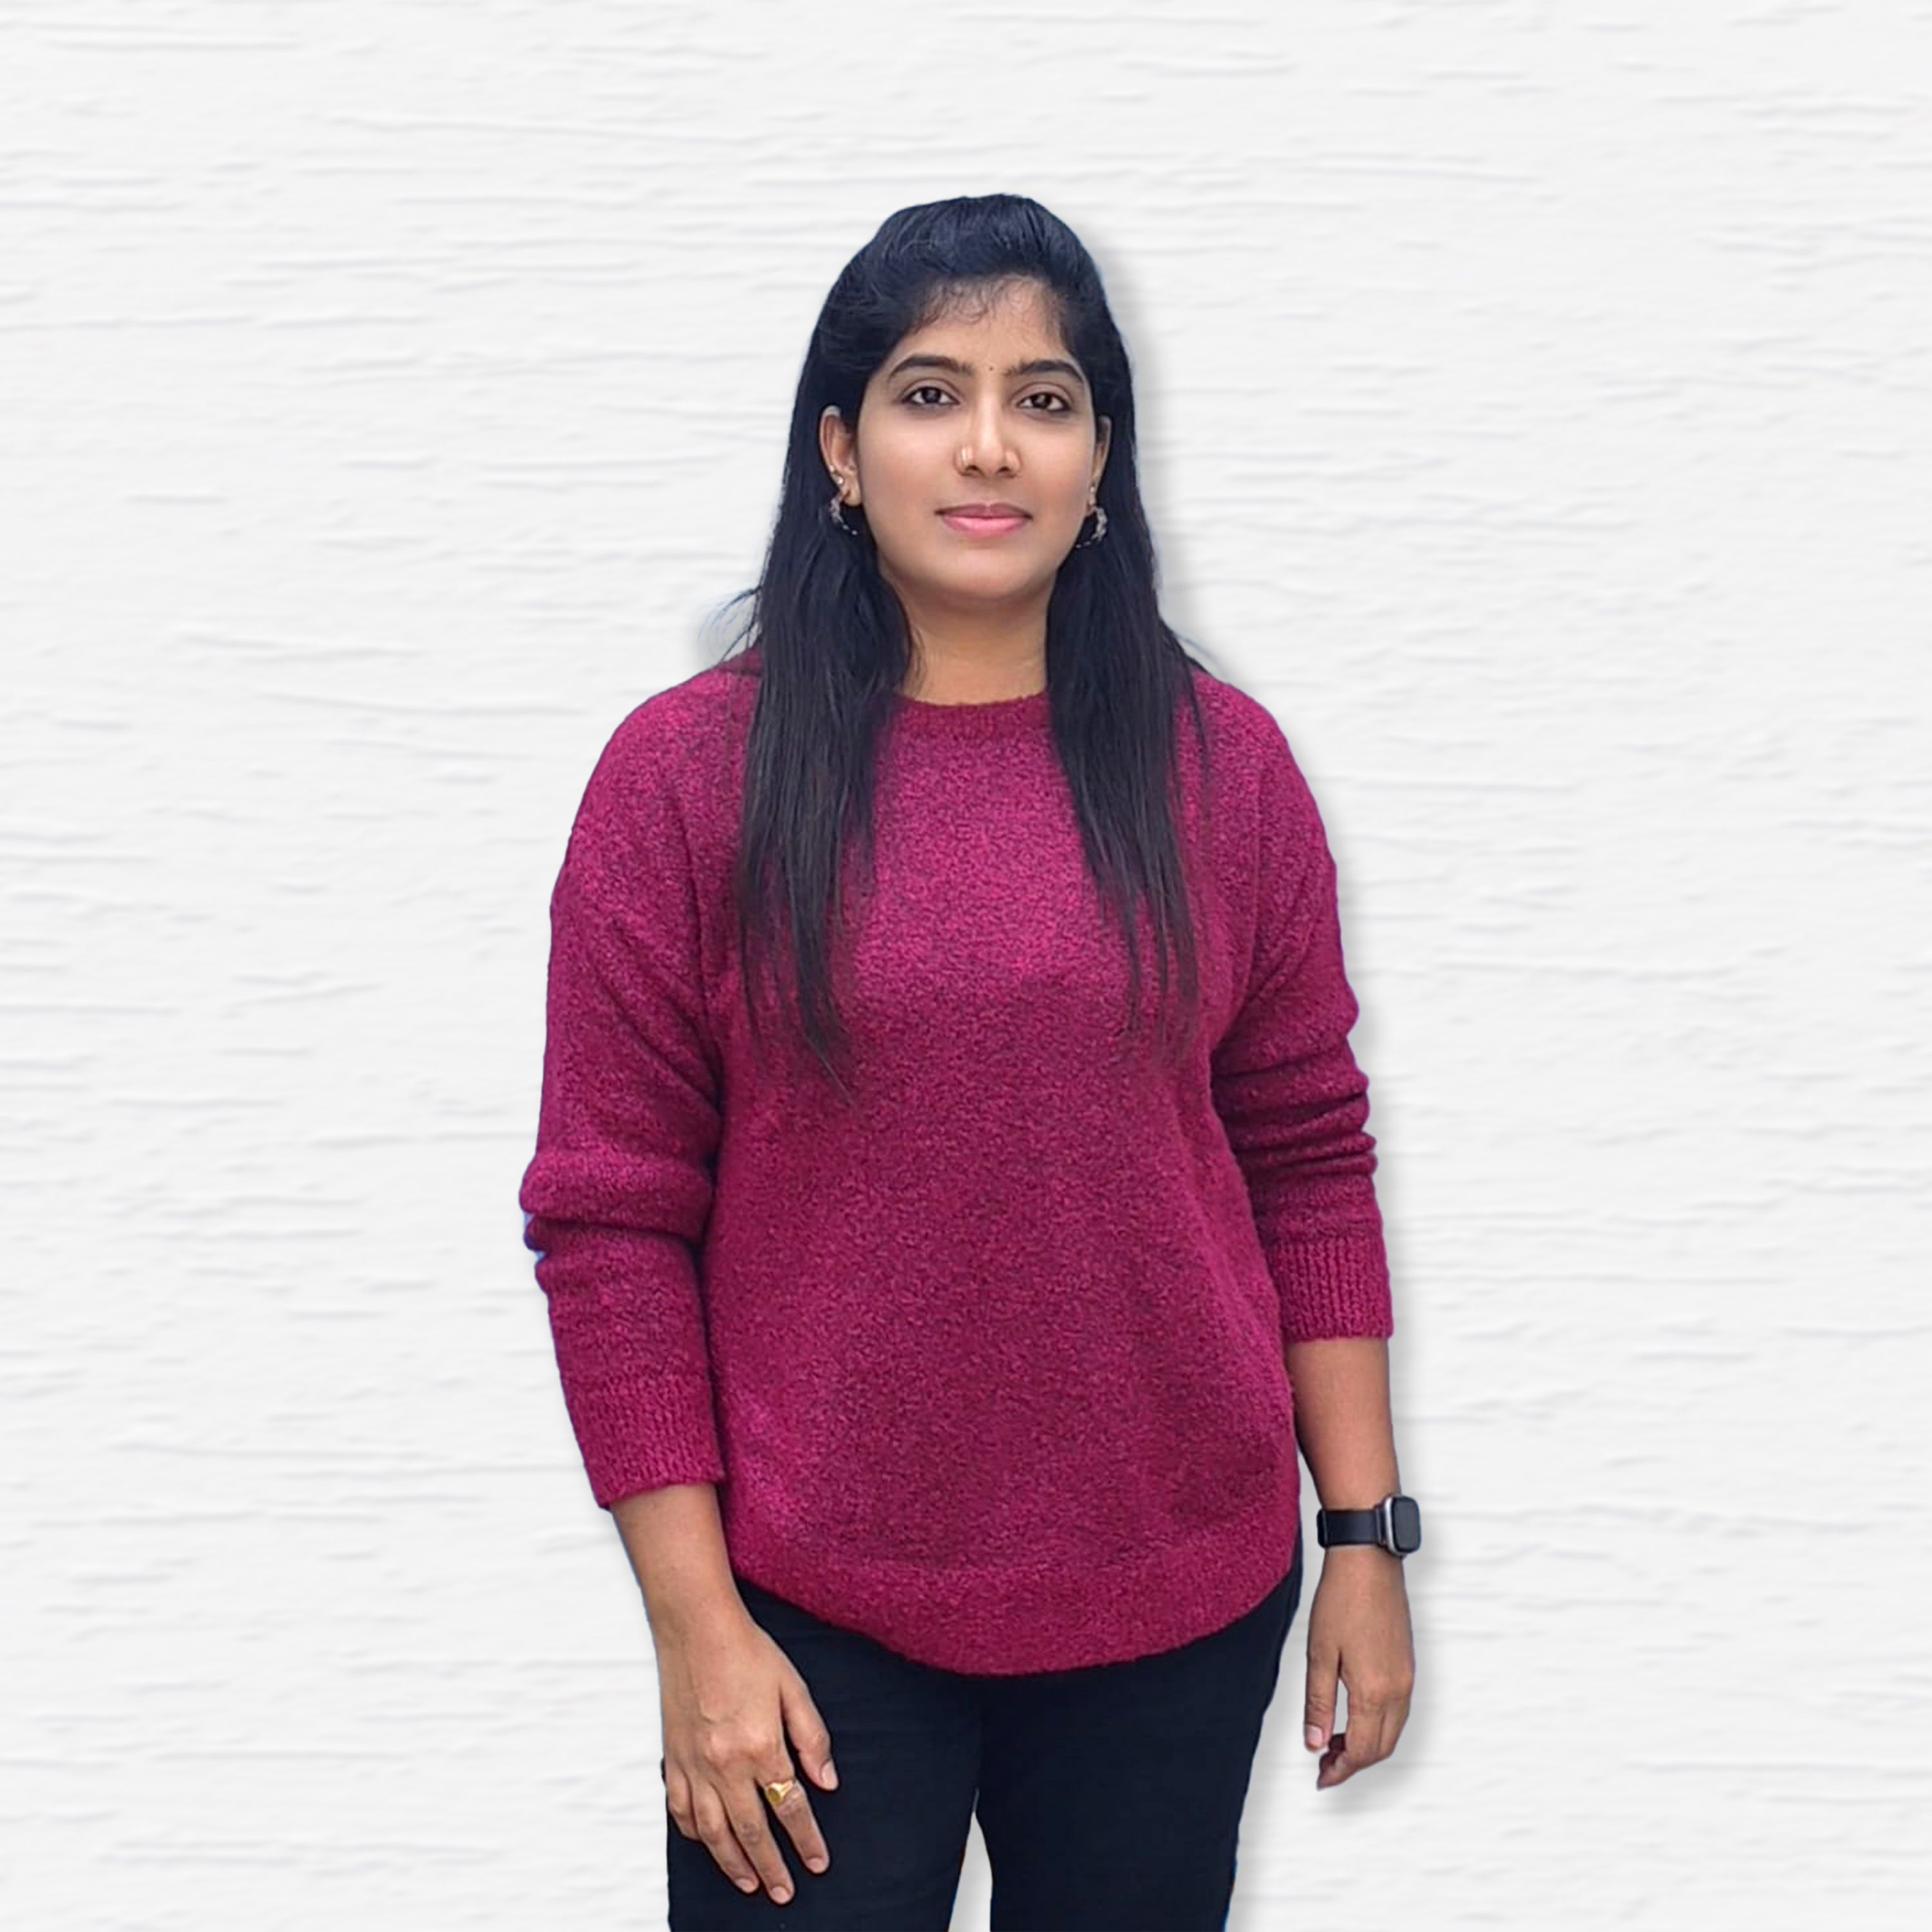
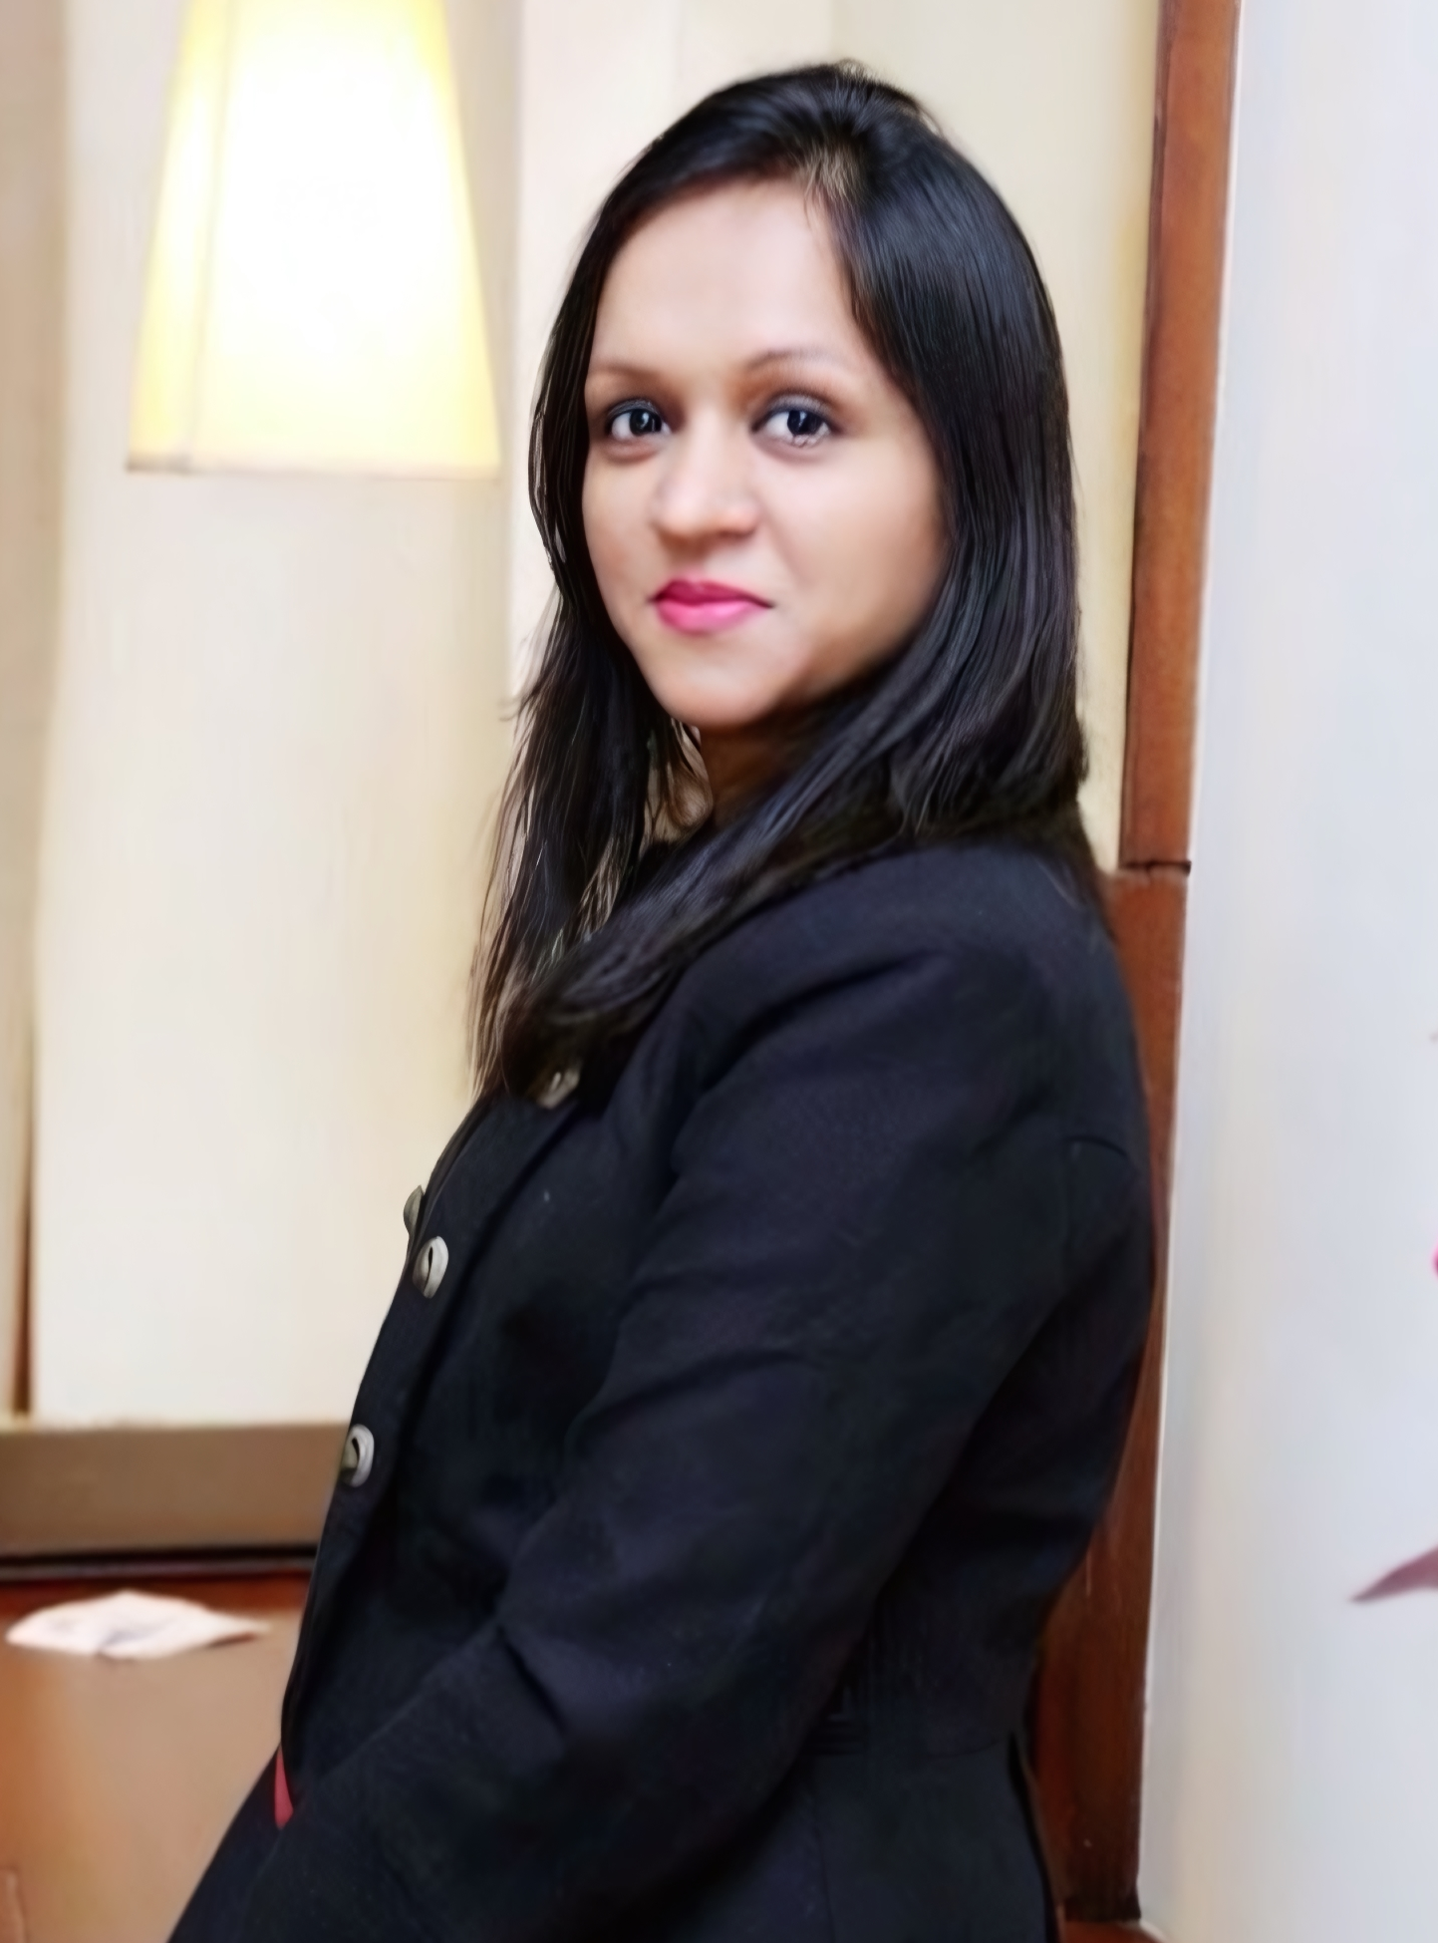
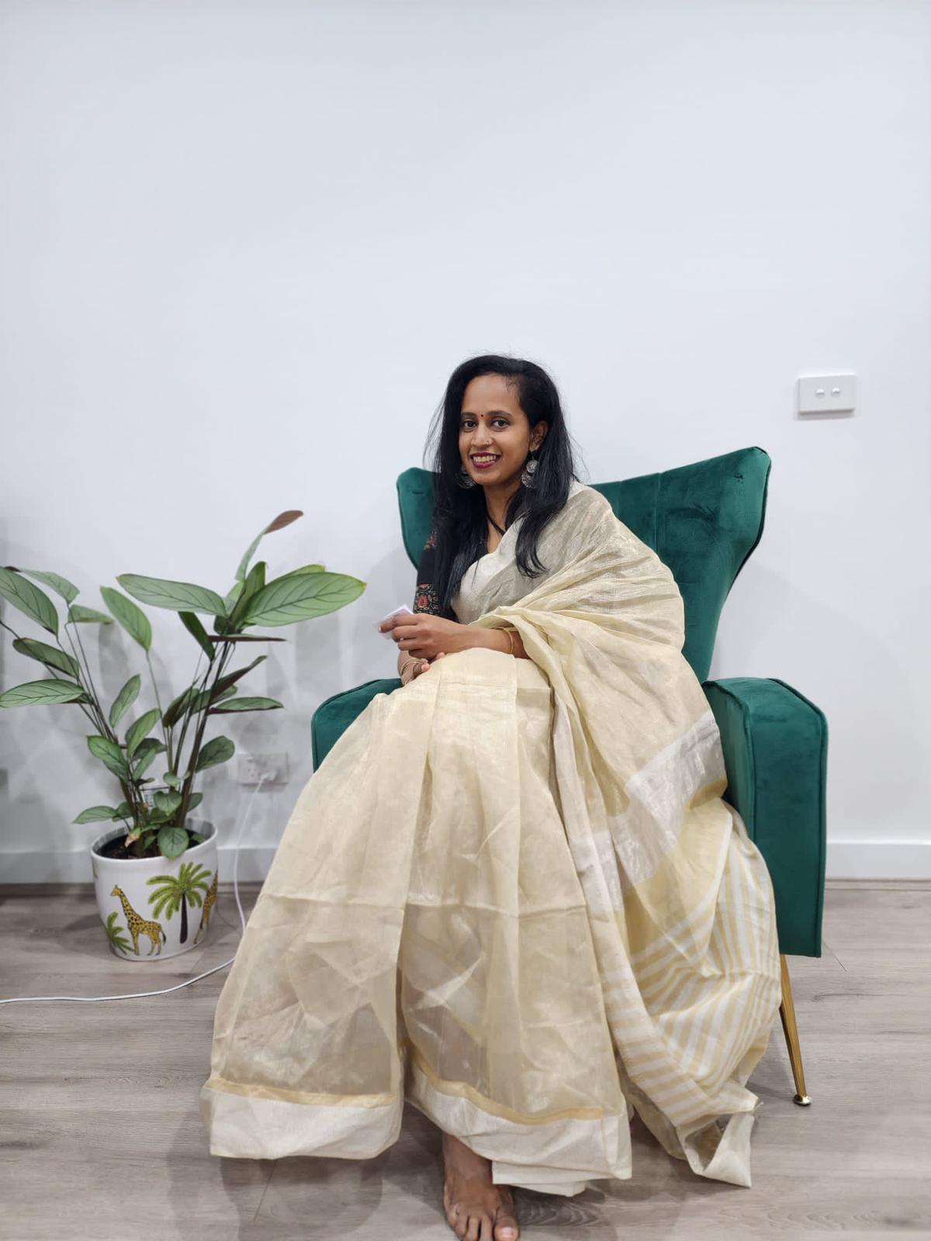
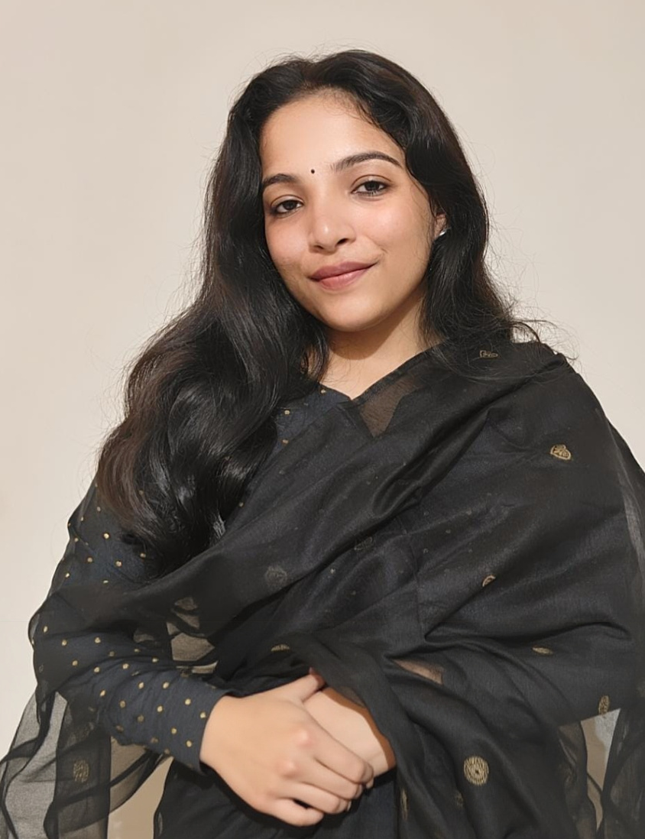
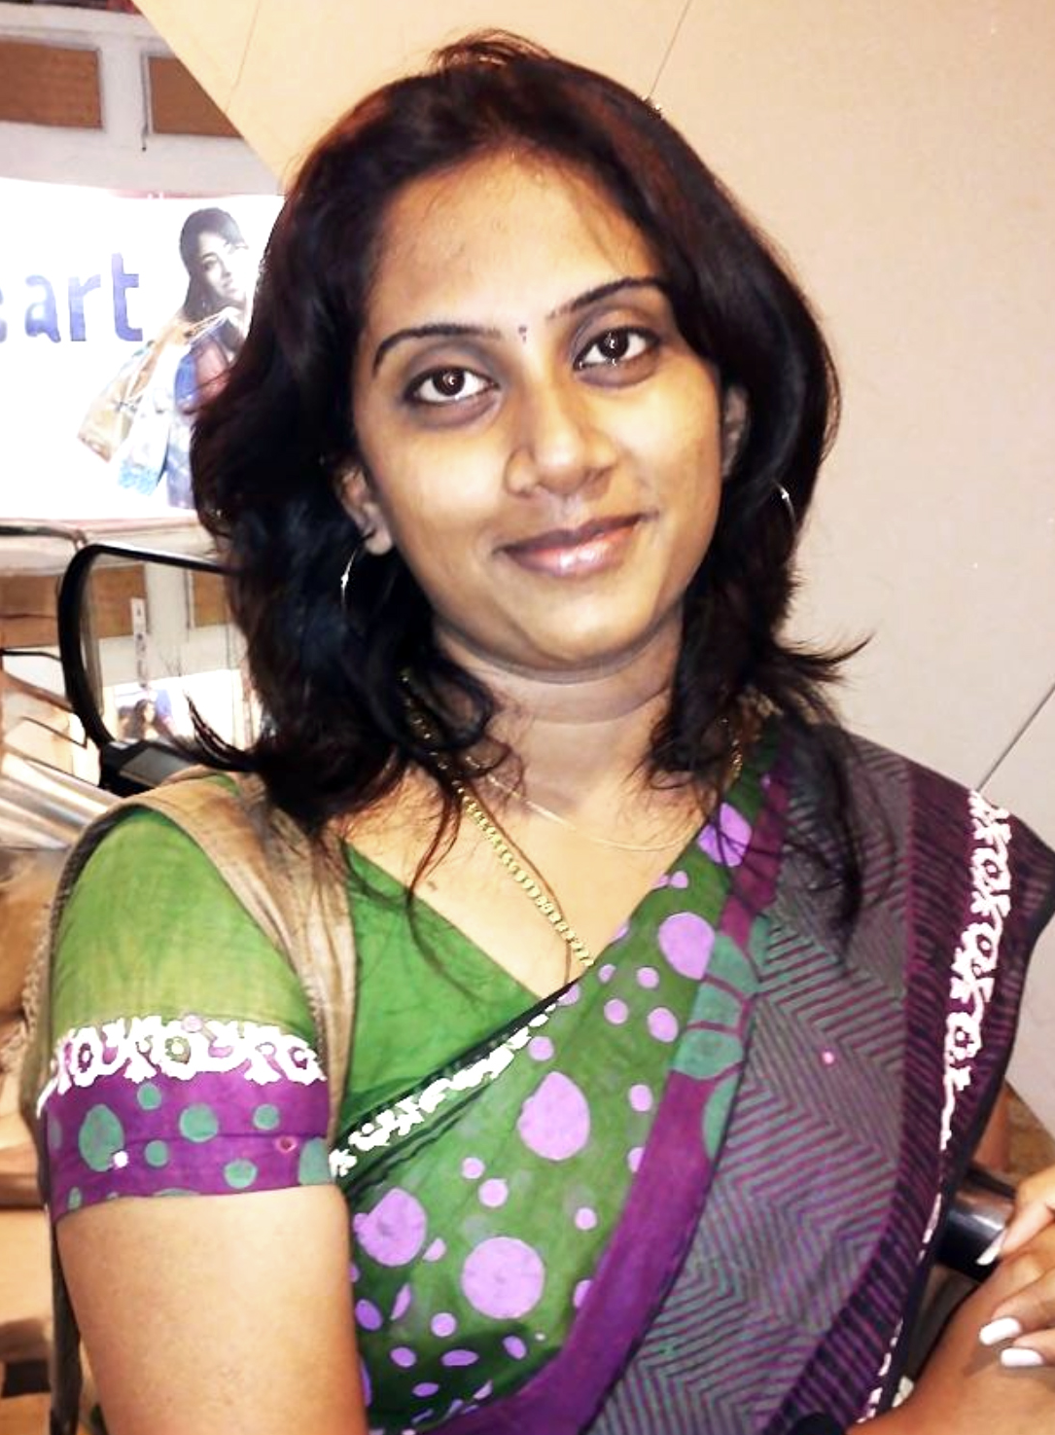
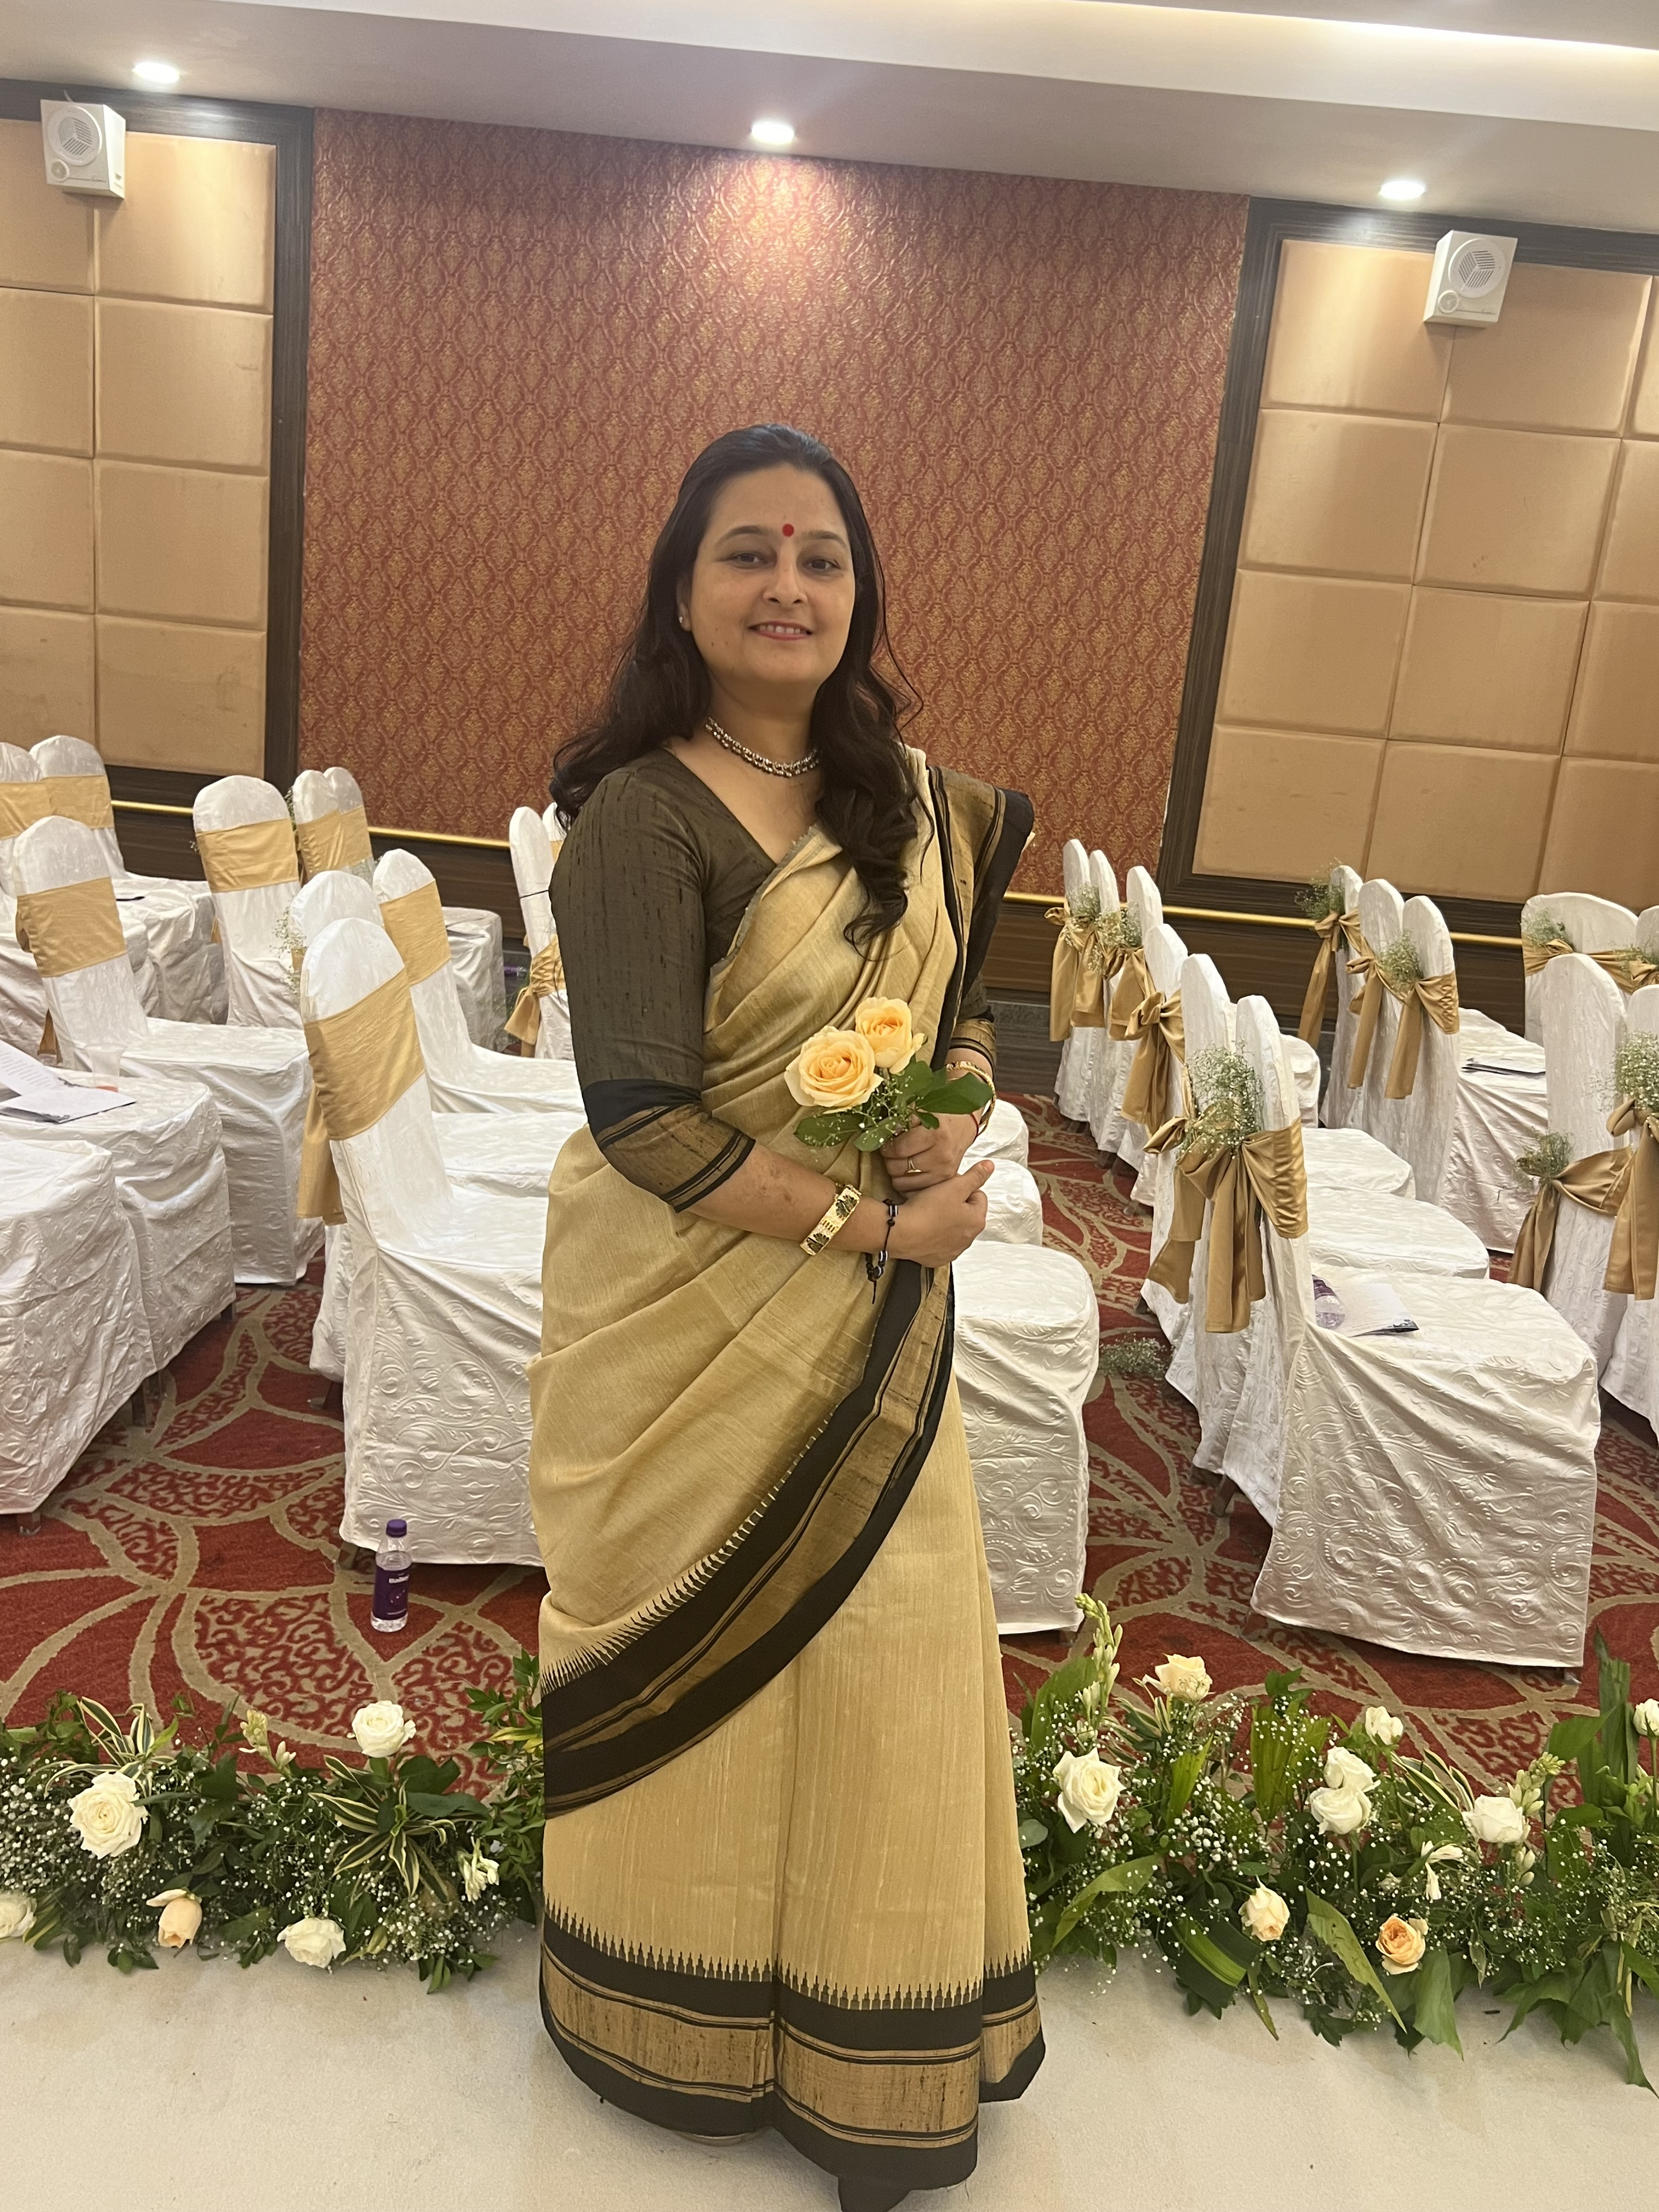
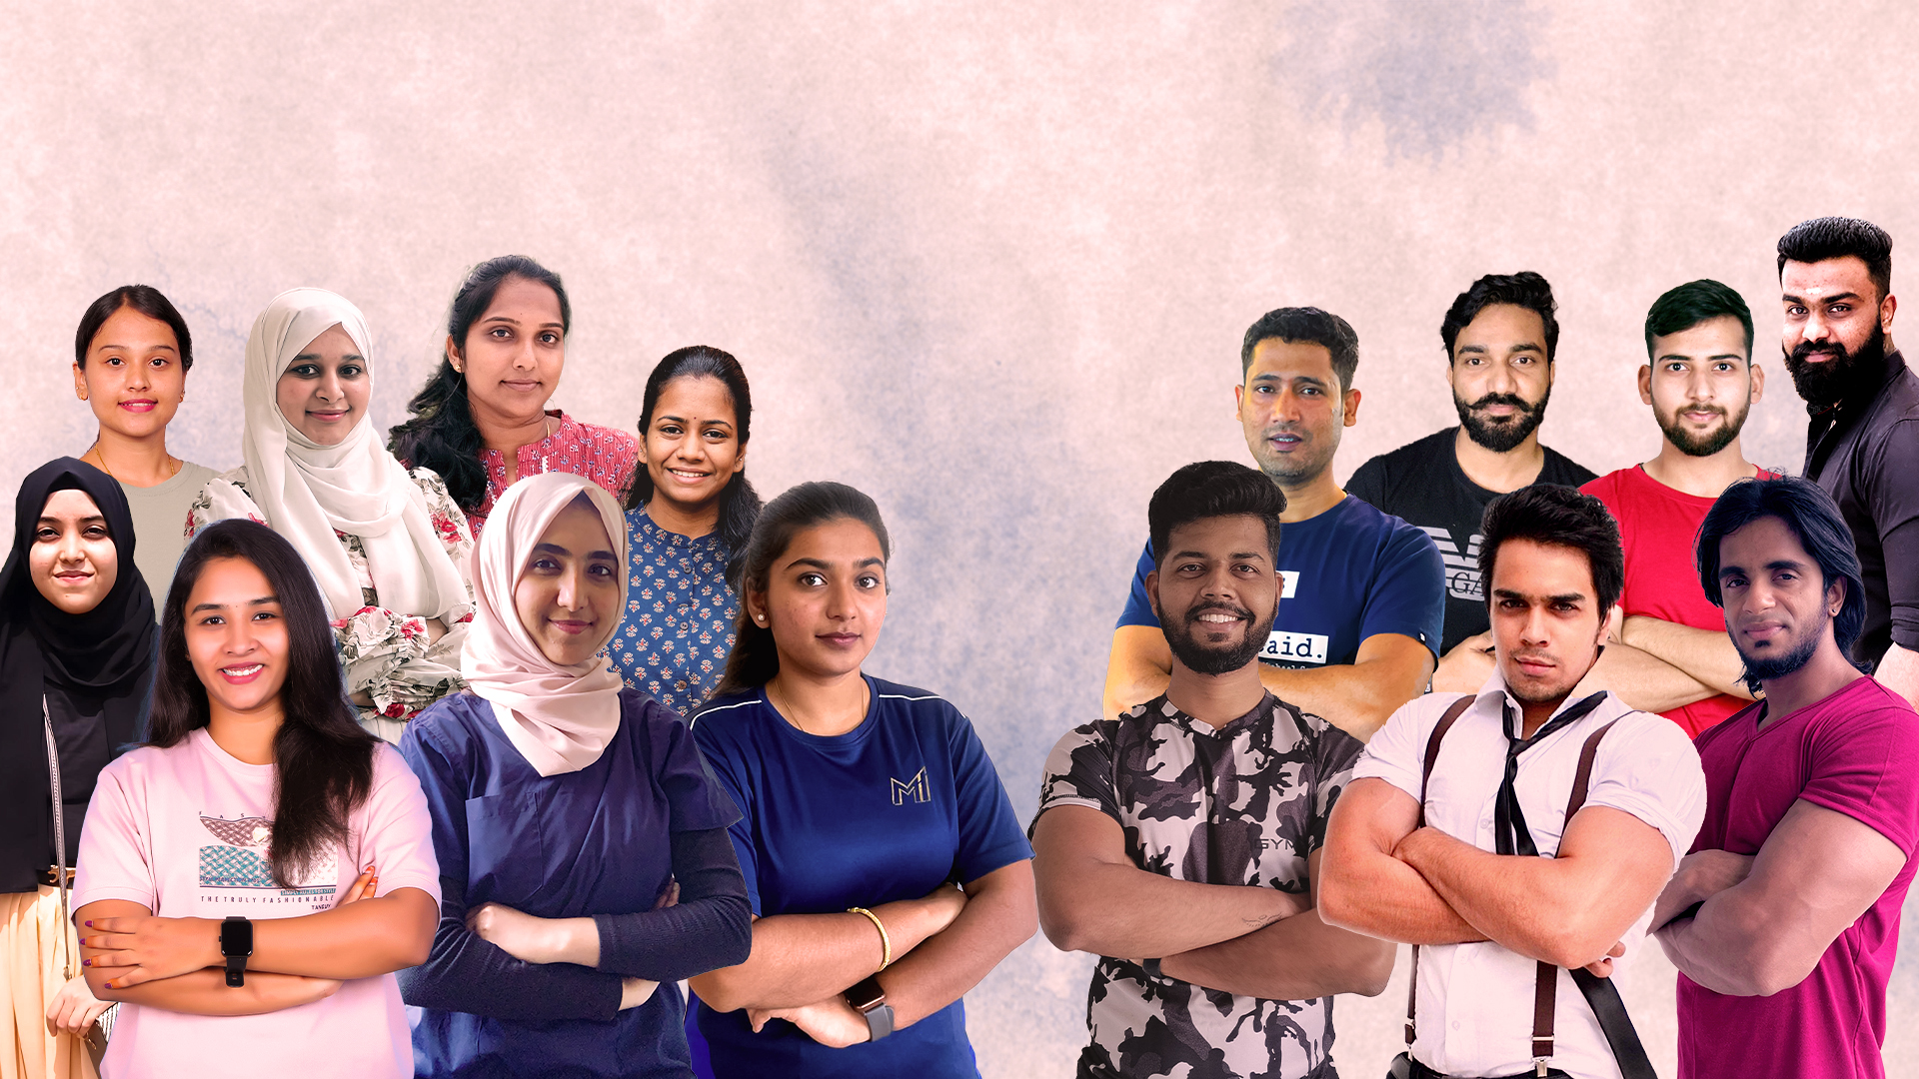
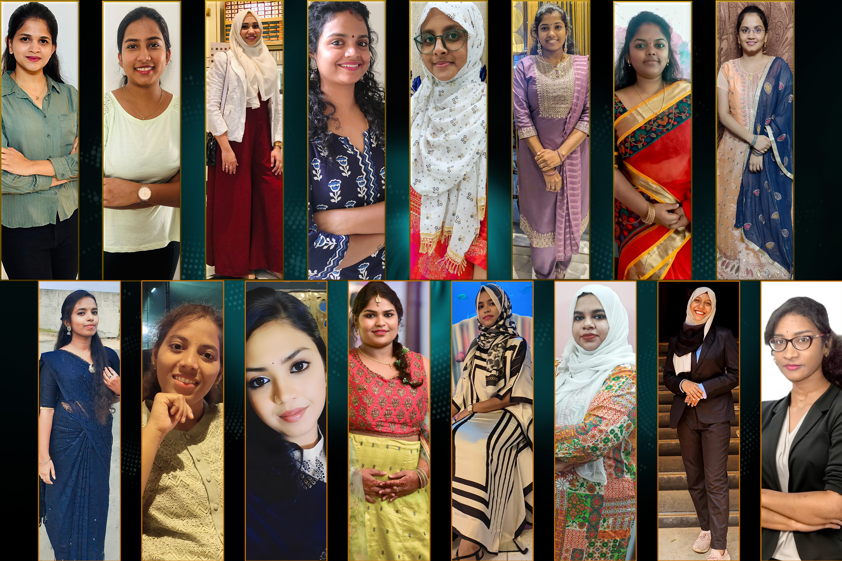
OUR TEAM
Nutrition Manager
Dr. Shruthi Poojary
Dr. Jananie V
Ms. Manisha Kothakonda
Ms. Kanu Jain
Ms. Suha Chandramouli
Ms. Bhumika Agrawal
Ms. Arthi Sujai
Dr. Sumedha Verma
Senior Fitness Manager
Subject Matter Expert - Fitness
Team Lead - Fitness
Nutrition Manager
Subject Matter
Expert - Nutrition
Senior Team Lead - Nutrition
Emotional Wellbeing Coach
Gynecologist
100+ Fitness Coaches
100+ Nutritionists
© 2025 FitMom Club. All Rights Reserved

Slide 7
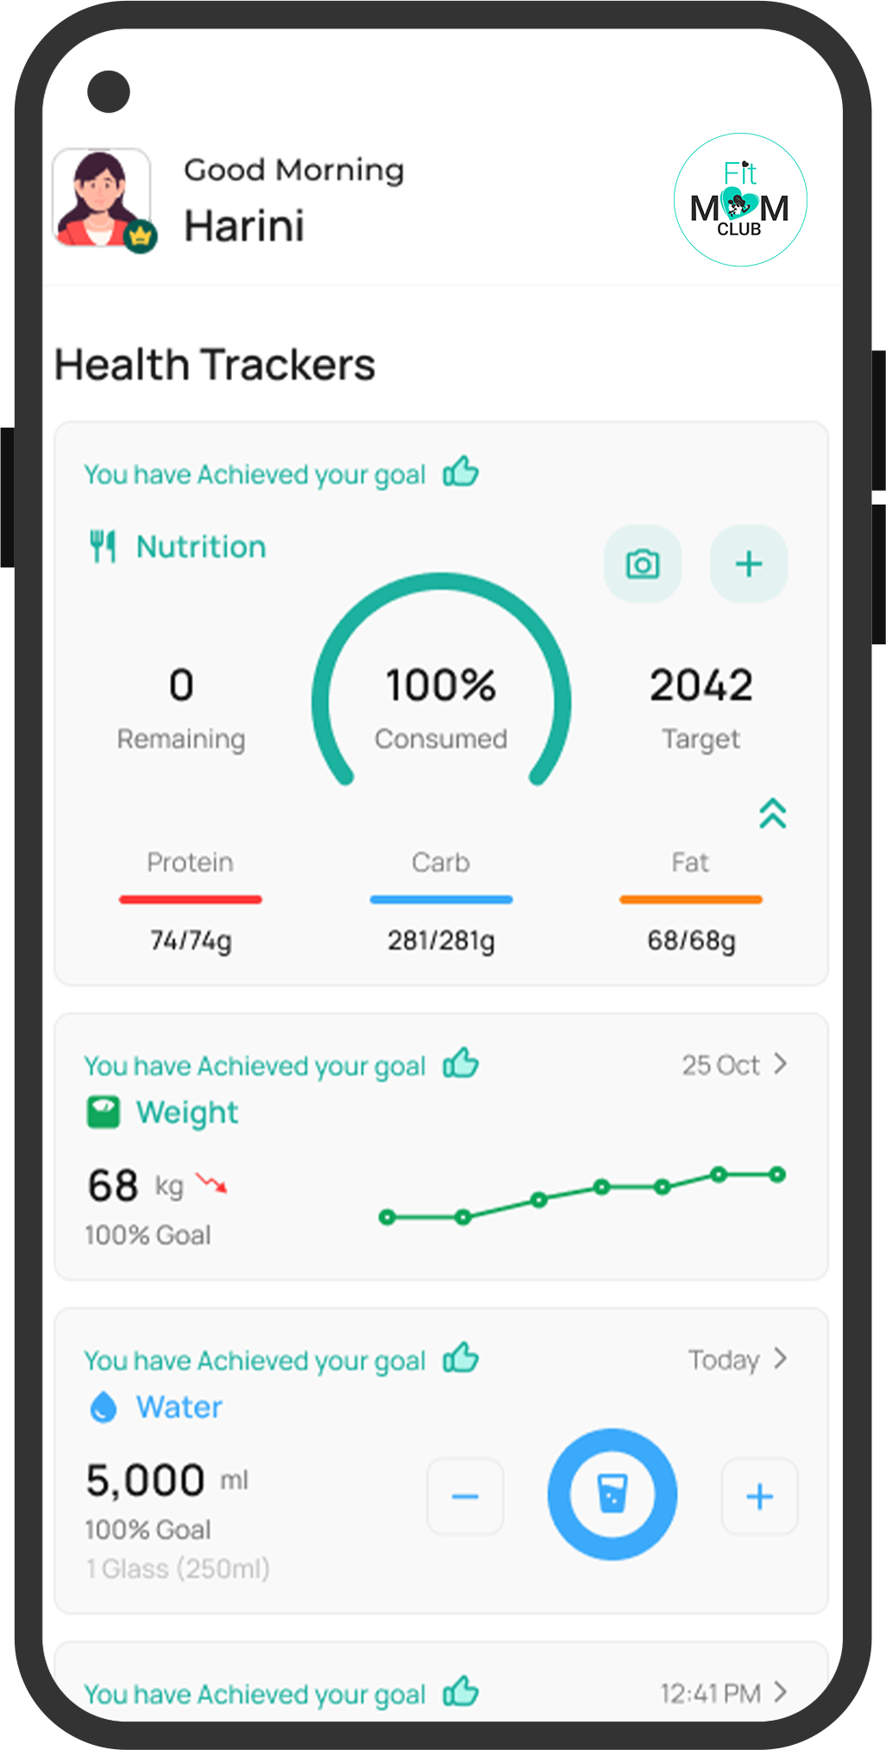







OUR STRENGTHS
We follow ICMR
& NIN, Nutrition
& Fitness Guidelines
1 Lakh+ Lives Transformed
98% Client
Success Rate
70+
Countries
80+ Live Studio Workouts Every Day
66k+ kgs Total Weight Loss
15k+
Health Reversals
FitMom Club
App
© 2025 FitMom Club. All Rights Reserved

Slide 8
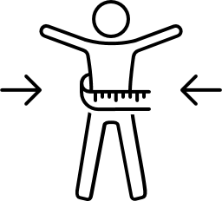








PROGRAM OFFERINGS
We are the # 1 Fitness & Wellness Community for Moms, Offering Diverse and Personalized Programs
Weight Management Programs
Health Condition Management Programs
Prenatal &
Postnatal Program
Miracle-Fertility Programs
Osteocare (Bone Health Program)
Family &
Buddy Programs
Tone up Program
Yoga Programs
Gut Reset Program
© 2025 FitMom Club. All Rights Reserved

Slide 9











KEY BENEFITS FOR MOMZ CRADLE
Full Transparency & Tracking
Brand Value Amplification
New Stream of Revenue
(Real-time insights, clear attribution, and weekly performance reports)
(Enhance your reputation by offering real value that matters)
(Authentic, passive revenue without changing your core Value)
Guaranteed Revenue Per Sign-Up
Seamless Operation
Benefits
Bridge to Better Health
(Connect your audience to life-changing wellness programs that reflect your care and credibility)
(Fixed payout or revenue share)
(We handle end-to-end process from lead follow-ups to service delivery)
© 2025 FitMom Club. All Rights Reserved

Slide 10







  VALUE FOR MOMZ CRADLE CLIENTS
We follow ICMR & NIN Approved Evidence-Based Nutrition & Fitness Guidelines
Science-backed Holistic Care by Health Expert Professionals
Support During Pregnancies &
Postnatal Recoveries
Clinically Designed
Customized Plan
For Every Health Conditions
Clients are Guided by Certified Dietitians
Exclusive Wellness Programs
No-fad Diet & Fitness; Sustainable, Long-term Results
Health Consultations
Health Consultation​
© 2025 FitMom Club. All Rights Reserved
Notes:
Support during pregnancy and postnatal recovery: Guided workout sessions for each trimester & DR, customized diet plans for mom’s health, lactation support, and baby’s growth.
Strengthens Momz Cradle’s brand loyalty: By offering wellness coupon cards with every purchase, Momz Cradle adds value to their customers beyond selling maternity wears. Moms/ Buyers see the brand as a true care partner who support their health and wellness. This creates stronger emotional connections, repeat purchases and long-term loyalty.
Strengthens Momz Cradle’s brand loyalty: Through this partnership, Momz Cradle can build deeper emotional connections with mothers, creating trust, repeat engagement, and long-term brand loyalty within the parenting community.

Slide 11

HOW OUR PARTNERSHIP WORKS
We’ll provide unique QR codes for your product packaging. Every verified conversion will generate revenue for Momz Cradle
© 2025 FitMom Club. All Rights Reserved

Slide 12
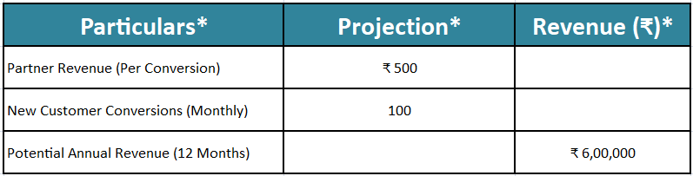
REVENUE PROJECTION
*Disclaimer:
The above projection is an approximate estimation based on assumptions. Actual revenues may vary depending on client volume, conversion rates, final agreed partner revenue and other operational factors.
© 2025 FitMom Club. All Rights Reserved

